Slide 1
Natural Language Processing
CSEL-383
Lecture 1 : Introductory Lecture

Slide 2
Lecture Roadmap
Logistics
Introduction to NLP

Slide 3
Introduction of Teacher
Farah Adeeba
Areas of interest
Natural Language Processing (NLP)
Machine Learning
Contact Details
farah.adeeba@uet.edu.pk

Slide 4
Grading/Evaluation
Quiz:20%
Project: 20%
Mid-term: 30 %
Final : 30 %

Slide 5
Assignments
Weekly class assignments will be posted on MS Teams
All class assignments will be in Python
The code and output will be submitted for evaluation on MS Teams

Slide 6
Lecture Format
Topic
Introduction
Conventional techniques
State-of-the-art techniques
Implementation in Python

Slide 7
Course Goals
Gain a foundational understanding in Natural Language Processing methods and strategies
Learn how to evaluate the strengths and weaknesses of various NLP technologies and frameworks
Gain practical experience in the NLP toolkits available
Make you a “producer” rather than a “consumer” of NLP tools (Assignments ☺ )

Slide 8
Required Texts and Readings
Speech and Language Processing, 3rd Edition, Jurafsky and Martin (https://web.stanford.edu/~jurafsky/slp3)
Natural Language Processing with Python, Bird and Klein, O’Reilly Media, 2009 (http://www.datascienceassn.org/sites/default/files/Natural%20Language%20Processing%20with%20Python.pdf)

Slide 9
Topics
Introduction of NLP
Basic Text Processing
Edit Distance & Text Similarity
Language Modeling
Text Classification and Sentiment Analysis
Information Extraction
POS Tagging
Parsing
Semantics and Text Resources
Question Answering
Machine Translation

Slide 10

What is Natural Language Processing

Slide 11
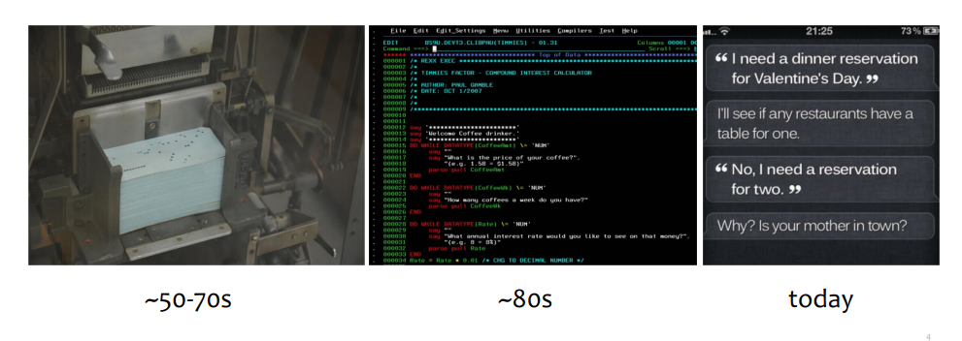
Communication With Machines

Slide 12
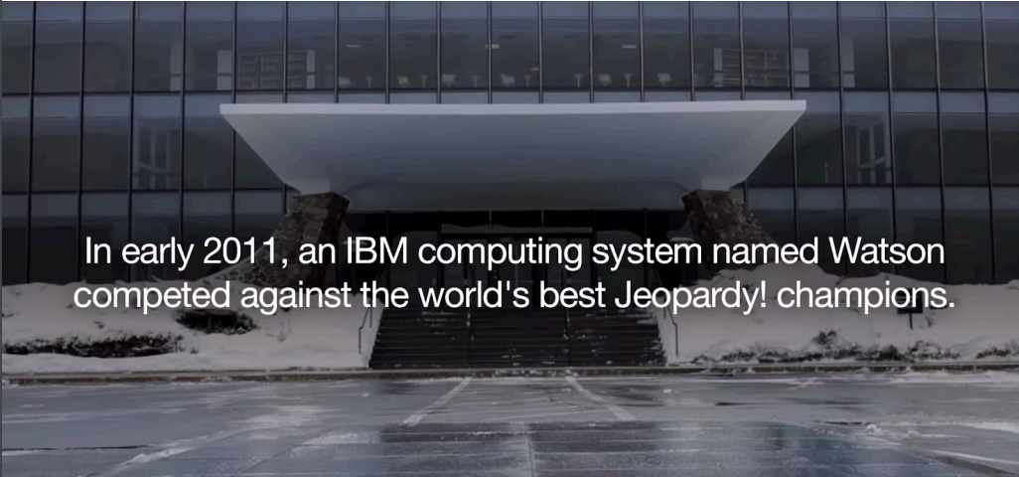

Slide 13
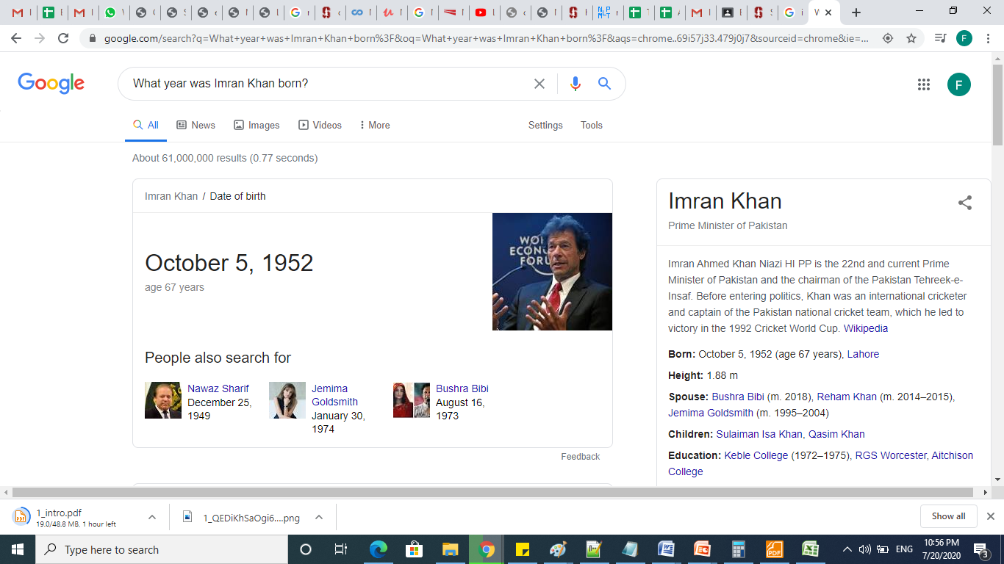
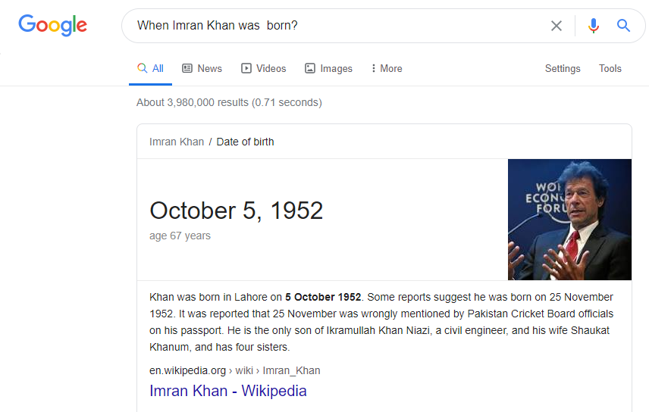
Question Answering

Slide 14

Translation

Slide 15
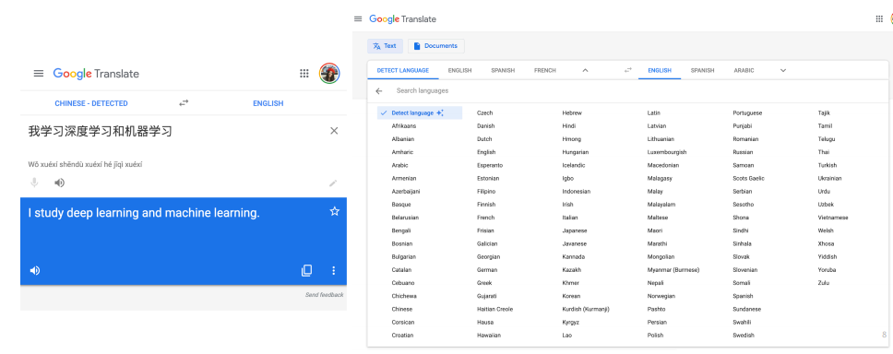
Machine Translation

Slide 16
Natural Language Processing
Applications
Technologies
Machine Translation
Information Retrieval
Question Answering
Dialogue Systems
Information Extraction
Summarization
Sentiment Analysis
……
Language modeling
Part-of-speech tagging
Syntactic parsing
Named-entity recognition
Word sense disambiguation
Semantic role labeling
……..

Slide 17




Language Technology
making good progress
Sentiment analysis
still really hard
mostly solved
Best roast chicken in San Francisco!
Question answering (QA)
The waiter ignored us for 20 minutes.
Spam detection
Coreference resolution
Q. How effective is ibuprofen in reducing fever in patients with acute febrile illness?
✓
Let’s go to Agra!
Paraphrase
✗
Carter told Mubarak he shouldn’t run again.
Buy V1AGRA …
Word sense disambiguation (WSD)
XYZ acquired ABC yesterday
Part-of-speech (POS) tagging
I need new batteries for my mouse.
ABC has been taken over by XYZ
ADJ ADJ NOUN VERB ADV
Summarization
Colorless green ideas sleep furiously.
Parsing
The Dow Jones is up
Economy is good
I can see Alcatraz from the window!
The S&P500 jumped
Named entity recognition (NER)
Machine translation (MT)
Housing prices rose
PERSON ORG LOC
第13届上海国际电影节开幕…
Dialog
Where is Citizen Kane playing in SF?
Einstein met with UN officials in Princeton
The 13th Shanghai International Film Festival…
Information extraction (IE)
Castro Theatre at 7:30. Do you want a ticket?
You’re invited to our dinner party, Friday May 27 at 8:30
Party May 27 add

Slide 18
What is NLP
Automating the analysis, generation, and acquisition of human (“natural”) language.
Analysis (“Understand”, or “process”)
Generation (generate sensible sentences, dialogs, robots)
Acquisition
NLP lies at the intersection of computational linguistics and machine learning.
This is not a linguistics course but we will discuss whole bunch of linguistics.
This is not a machine learning course but we will using machine learning through out the course

Slide 19
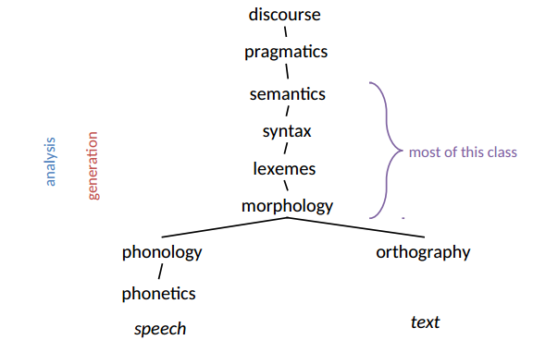
Levels of Representation

Slide 20
Why NLP is Hard
Ambiguity
Expressivity
Variation

Slide 21
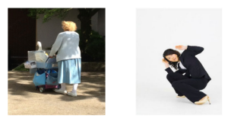
Ambiguity
Ambiguity at multiple levels
Word senses: bank (finance or river ?) , باب
Part of speech: chair (noun or verb ?), کھانا
Syntactic structure: I can see a man with a telescope

Slide 22
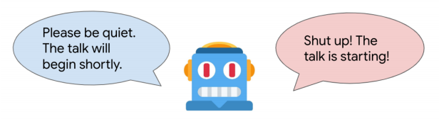
Expressivity
Not only can one form have different meanings (ambiguity) but the same meaning can be expressed with different forms:
شاہینہ نے نورینہ کو مارا vs نورینہ کو شاہینہ نے ما را
اگر کھڑکی کھلی ہوئی ہے تو بند کر دو vs برائے مہربانی کھڑکی بند کر دیں

Slide 23
Variation
non-standard Language
segmentation issues
idioms
Great job @justinbieber! Were SOO PROUD of what youve accomplished! U taught us 2 #neversaynever & you yourself should never give up either♥
dark horse
get cold feet
lose face
throw in the towel
the New York-New Haven Railroad
the New York-New Haven Railroad
neologisms
world knowledge
tricky entity names
unfriend
Retweet
bromance
Mary and Sue are sisters.
Mary and Sue are mothers.
Where is A Bug’s Life playing …
Let It Be was recorded …
… a mutation on the for gene …
But that’s what makes it fun!

Slide 24
Making progress on this problem…
The task is difficult! What tools do we need?
Knowledge about language
Morphology: word formation
Syntax: word order
Semantics: word meaning and word composition
Pragmatics: influence of context/situation
Knowledge about the world
A way to combine knowledge sources
How we generally do this:
probabilistic models built from language data
P(“maison” → “house”) high
P(“L’avocat général” → “the general avocado”) low
Luckily, rough text features can often do half the job.

Slide 25
Fields with Connections to NLP
Machine learning
Linguistics (including psycho-, socio-, descriptive, and theoretical)
Cognitive science
Information theory
Logic
Data science
Political science
Psychology
Economics
Education

Slide 26
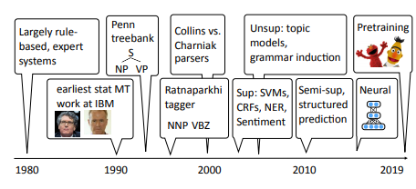
A Brief History of NLP

Slide 27
What is Python
General-purpose, high-level scripting language
Used for a wide variety of purposes including networking and web applications
Most popular in the scientific community for its ease of use

Slide 28
Why Python
Easy to understand and write
A simple yet powerful programming language with excellent functionality for processing linguistic data
Installers are available at all platforms
Python is heavily used in industry, scientific research, and education around the world

Slide 29
What’s Next ?
Python Introduction

